Slide 1
Layered LDPC Decoder.
By Tirthankar Mittra.

Slide 2
Contents.
Brief explanation of the idea .
What is Layered Decoding ? Advantages of it.
Explanation of Reinforcement Learning and Bellman Equations.
Illustration of idea using the toy example.
5. Benefits of the idea.

Slide 3
Brief explanation of the idea.
LDPC decoder is used in NR for Downlink and Uplink Shared Data Channel's encoding and decoding. Layered LDPC decoding is done layer by layer. Decoded result of one layer in H matrix is used as input to another layer, because of which Layered LDPC Decoder converges faster to the solution.
I have used Reinforcement learning (Bellman equations) to determine taking which layer first will provide faster convergence ( 3GPP doesn't specify which layer's result must be taken first ). In other words I have determined the order in which the layers must be taken for even faster convergence to the solution.

Slide 4
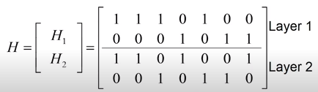
Layered Decoding
Rows of parity check matrix grouped into several layers.
Column weight of each layer =1 (typically)
We perform LDPC decoding using layer 1 first. Use the result obtained in layer 1 to perform decoding for layer 2. This ensures faster convergence compared to normal method where we use the result obtained in different layers in the next iteration instead of using it immediately.

Slide 5

Reinforcement Learning & Bellman Equations.(1/7)
The diagram shown above gives a general idea of Reinforcement learning.
- The Agent chooses a valid action At for a given state St.
- Based on the action the Environment transitions from the current state St to the next state St+1.
- The Environment also decides the reward Rt+1 for the next state St+1.
- Based on St+1 the Agent again chooses valid action At+1.
The job of the Agent is to choose actions which will lead to states providing the highest cumulative rewards
in the future, the idea of future rewards is captured by value function.
The main objective of reinforcement learning is to a find optimal policy i.e. mapping between states of the environment and actions such that maximum total reward is generated over the entire duration of time.
Notes:
The number of possible policies is equal to the number of actions to the power of number of states.
Policies are of two types Deterministic Policies and Stochastic policies.

Slide 6
Reinforcement Learning & Bellman Equations.(2/7)
Elements of Reinforcement Learning that needs to be determined for successful implementation :-
1. Policy.
A policy defines the learning agent’s way of behaving at a given time. Roughly speaking, a policy is a mapping from perceived states of the environment to actions to be taken when in those states.
2. Reward Signal.
A reward signal defines the goal in a reinforcement learning problem. On each time step, the environment sends to the reinforcement learning agent a single number, a reward.
3. Value Function.
Roughly speaking, the value of a state is the total amount of reward an agent can expect to accumulate over the future, starting from that state.
4. Model Of Environment.
This is something that mimics the behavior of the environment, or more generally, that allows inferences to be made about how the environment will behave.

Slide 7
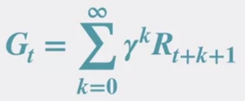
Reinforcement Learning & Bellman Equations.(3/7)
For us, to use the Bellman Equations and simplify the process of incorporating future rewards when selecting a particular action we formulate our problem in such a way that it satisfies the dynamics of Markov Decision Process(MDP).
A process is called a MDP if the present state contains all the information necessary to predict the future.
Some properties of using MDPs are :-
MDPs provide a general framework for sequential decision-making.
The dynamics of an MDP are defined by a probability distribution.
The future reward can be calculated as follows where Gt is the future reward calculated from time t
Where Rt is the immediate reward at time t. γ is the discount factor for future rewards which lie between 0 to 1(inclusive).

Slide 8

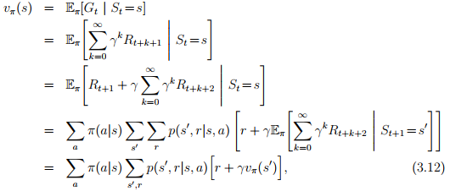
Reinforcement Learning & Bellman Equations.(4/7)
The Bellman Equation can be used to find state value function. State value function is defined as the expected reward received over long term Gt from current state St when a policy π is followed.
Mathematically it can be represented as follows.

Slide 9

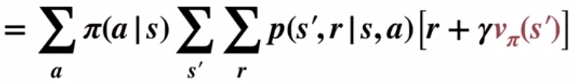





Reinforcement Learning & Bellman Equations.(5/7)
The Bellman Equations can be recursively written as follows.
Where,
s’ -> is the next state.
s -> is the current state.
a -> is the action chosen in the current state s.
r -> is the reward received on choosing the action a in state s.
π -> is the policy based on which the action is chosen.
In our idea one action will lead to an unique state and reward.[We are using Deterministic Policy]
For this reason term will evaluate to 1 i.e. the probability will be
1 for the unique state and 0 elsewhere.
So, the above equation will simplify to,
The best policy π* will choose action which maximises i.e.
So if we find maximum we can find the best policy π*(Our aim). Using the following formula below.

Slide 10

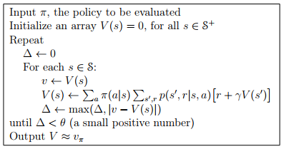
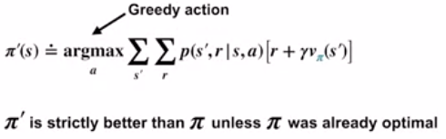
Reinforcement Learning & Bellman Equations.(6/7)
ITERATIVE POLICY EVALUATION.
This is a system of |S| simultaneous linear equations in |S| unknowns.
We use the well known technique of iterative method to solve this system of linear equation. The above formula changes to
where k is the k-th iteration.
This algorithm is also known as iterative policy evaluation.
POLICY IMPROVEMENT THEOREM. -> We can construct a strictly better policy by acting greedily w.r.t the value function of given policy.
In our algorithm we start with a policy π and use this technique to get a better policy.

Slide 11
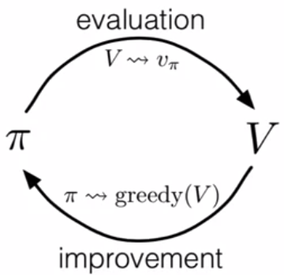



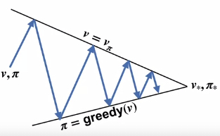
Reinforcement Learning & Bellman Equations.(7/7)
First we take a policy to evaluate the value function as shown below.
Then we use the value function to evaluate new policy using POLICY IMPROVEMENT THEOREM. as shown below.
We use this process until we find the optimal policy. Optimal policy is said to be found when there is no further change in the policy.
Pictorially the above idea can be demonstrated with the following two diagrams on the right side. In the code I have implemented I have only used the POLICY IMPROVEMENT THEOREM once.[ Used once since not much policy improvement is expected and it will increase code complexity ]

Slide 12
Illustration Of the Idea( with an example )
First we create the state transition diagram for our idea.
Let there be L layers in the H matrix.
Here I propose that there be one initial state S0.
The set of valid actions from state S0 might look like { “0,1,2,..,L” , “1,4,..,L” , ……} .
Action “0,1,2,..,L” means Layer 0 is used first, then the result of Layer 0 is used in Layer 1, then the result of Layer 1 is used in Layer 2 so on and so forth. So for S0 there are L! total valid actions and since one action leads to one state we have L! next states.
This will lead to huge computation complexity.
Another version( which I implemented ) is to form subgroups. To better understand this concept let’s take the following example.
Let’s assume L= 9 and The size of each subgroup to be 3.
In the above example the layers are designated as 0,1,2,3,4,5,6,7,8
A subgroup is designated by taking any 3 layers together i.e. {0,3,6} is a valid subgroup.
For reducing time complexity of the algorithm we will assume that permutations within a subgroup will produce no effect.
Let’s say we take subgroup {0,3,6} then we have to take a subgroup which excludes the layers 0,3,6 (6C3 possibilities) lets say we take {1,2,5} subgroup now we have to select a subgroup which excludes layers 0,3,6,1,2,5 (3C3 possibilities ) so we have to take {4,7,8}. As a policy (our original policy) we do not repeat layers in the next selection because repeating same layers won’t produce faster convergence.

Slide 13
Illustration Of the Idea( with an example )
So the valid action [{0,3,6},{1,2,5},{4,7,8}] will give rise to next state S1.
As a general rule if Number of Layers are L and subgroup size is s (We choose s such that L%s=0 for simplicity). Then the number of next states will be equal to LCs*(L-s)Cs*…..*(L-(L/s-1)s)Cs where nCr is combination of taking r things out of n things.
So for our example the number of next states will be 9C3*6C3*3C3(=1680). The state transition diagram is shown below.
Once we reach the terminal states ( shown in green ) we call the layered LDPC decoder. Lets say when we reach S1 we call the layered LDPC decoder with valid action [{0,3,6},{1,2,5},{4,7,8}]. Layered Decoder will first decode layer 0,then layer 3(using results of layer 0) and then layer 6. After this the decoder will check whether the codeword has converged to a solution i.e. if [H matrix] * [ Code word's transpose ] = [Zero Matrix] where * is matrix multiplication in this context.
S1
S2
SO
.
.
.
S1681

Slide 14
Illustration Of the Idea( with an example )
If the codeword doesn’t converge we add -1 to reward and proceed with the next subgroup {1,2,5}. If the codeword doesn’t converge i.e. [H matrix] * [ Code word's transpose ] = [Zero Matrix] we again add -1 to reward and proceed with the next subgroup {4,7,8}. After completing all the subgroups we have completed one iteration. We will continue this process until maximum allowed iterations have been reached or until the codeword converges. If the codeword converges we add 5 to the reward and return it.
The above process is repeated for all the states S1,S2…,S1681.
CONCLUSION OF THE EXPERIMENT PERFORMED
I ran the code for a codeword of size(n=15) and message bits of size(k=6) with number of layers(L=9) and subgroup size(=3) once. You can run the code for a single codeword multiple times to get optimal value function. [ according the concept explained in previous slides ].
I found out that for that codeword performing decoding using certain ordering of layers provided faster convergence and performing decoding using certain ordering of layers provided slower convergence to the solution.

Slide 15
Benefits Of the Idea.
We find the arrangement of layers[ using Reinforcement Learning ] of decoding for layered LDPC decoder which provides faster convergence to the final decoded codeword.
We can run our code for multiple code words and can find out if there is a general pattern in which performing decoding can provide faster convergence. If a general order is found to be better we can use it for decoding in future.
We can group code words into groups such that in that group performing layered decoding with a particular ordering can yield faster convergence. This type of grouping can help in decoding.
This algorithm is not time consuming for small code words. Much of research is ongoing for small sized code word's decoding using LDPC decoders. This technique provides valuable input into what type of layered decoder provides faster convergence.

